Slide 1

Analyzing Food Product Data
Presented by: Octave Antoni
Last Updated: September 19th, 2022

Slide 2
Table of contents
Introduction
Dataset
Key figures
Correlation analysis
Conclusion

Slide 3
Introduction
Project based on an the open food database (downloadable at https://world.openfoodfacts.org/)
Analyze the data ➔ Univariate and bivariate analysis
Main objective ➔ Present the analysis to a wide audience.
Analysis of product data, highlighting key figures
Multivariate analyses ➔ Measuring correlation
Proving hypotheses ➔ descriptive and exploratory analysis

Slide 4
Dataset

Slide 5
Dataset
Dataset = 1 csv table, initially 161 columns
Filtered down to 20 columns, including 5 categorical and 15numeric variables
Removed columns with more than 90% NA values
Removed tagged columns with duplicate information
Removed categorical variables with >100 unique values
Removed site specific and user specific variables
Removed the quantity column since all nutrients are for 100g
Calculated 2 columns : Nutrition score grades for UK and France

Slide 6
Data cleaning
Removed rows with incoherent values (ex. 150g / 100g)
Removed rows based on maximal possible energy value for 100g (3762kJ)
Removed row with no energy information, and no information on all of the 3 principal nutrients (fat, proteins and carbohydrates)
Deleted duplicate rows and product names
Analysis of categorical variables and replacement of mistypes based on calculation of Levenshtein distance
Data imputation (median) for NaN numeric values

Slide 7
Key figures

Slide 8
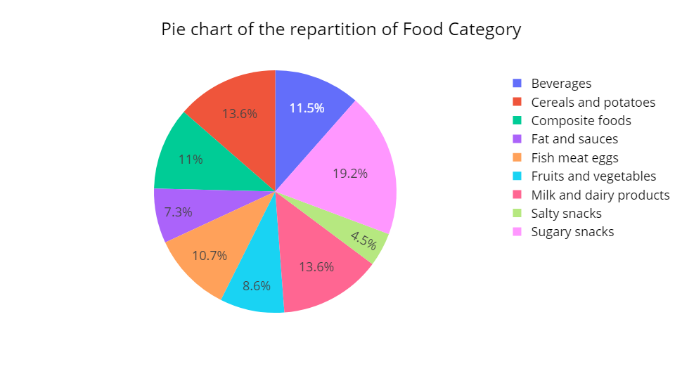
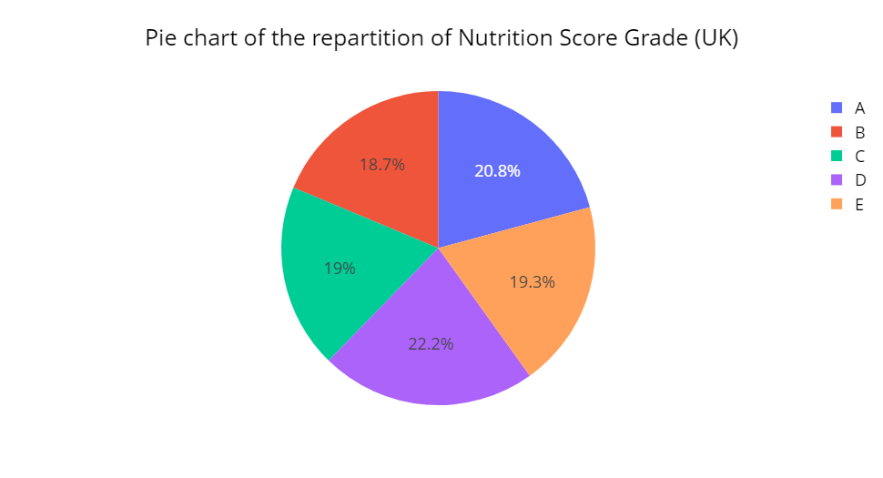
Repartition of food products
Sugary snacks is the most represented category with 19.2% of products
Salty snacks is the least represented category with only 4.5% of products
There is a good repartition of Nutri Scores with D and B the most and least represented at 22.2% and 18.7% respectively

Slide 9
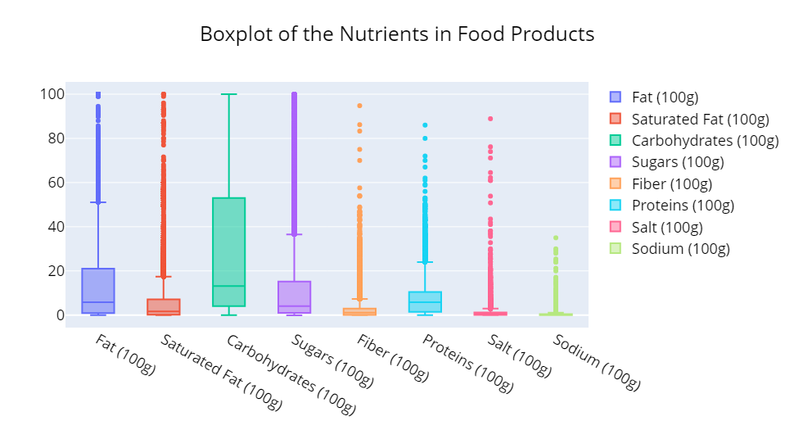
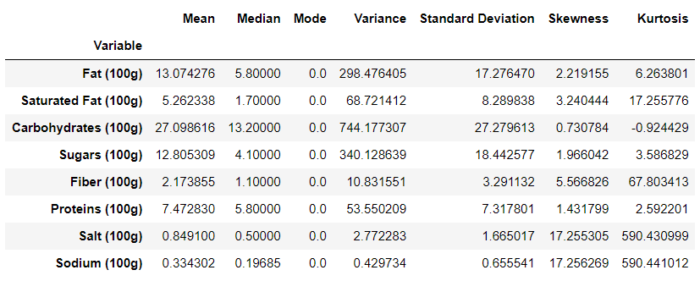
Distribution of Nutrients
Carbohydrates has the widest spread and Inter-Quartile Range (IQR)
Carbohydrates and Sugars have the highest variance, standard deviation.
Salt and Sodium have the lowest variance, standard deviation, mean and median values.
Carbohydrates and Fat have the highest mean and median values.
Salt and Sodium have the highest Skewness and Kurtosis (peakness)

Slide 10
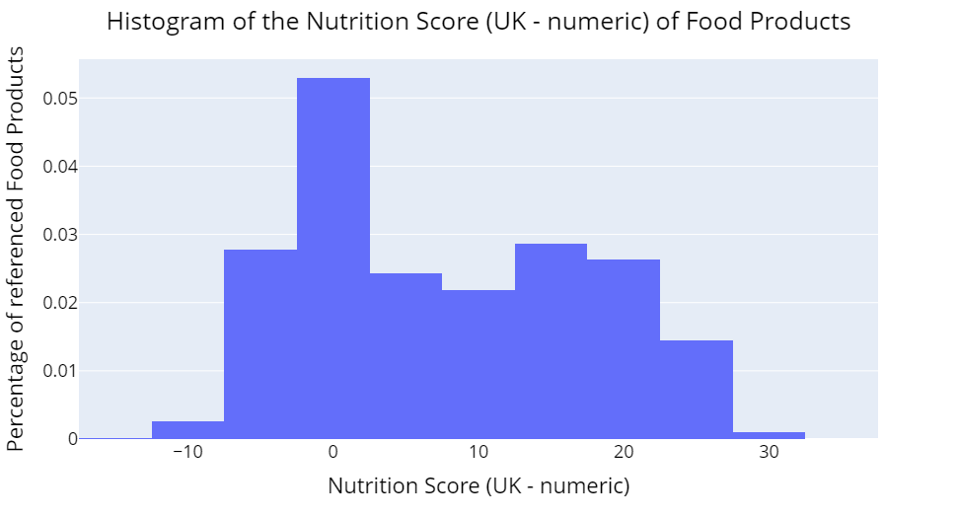
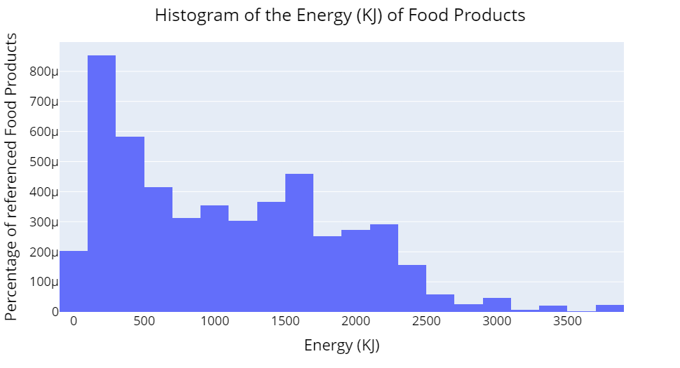
Distribution of Nutrition Score and Energy
Both Nutri Score and Energy are not normally distributed
We can see that there are 2 peaks for both variables at 0-15 for Nutriscore and 250-1500 for Energy (KJ / 100g)
High Variance and standard deviation for Nutriscore and Energy (627,971/792 for energy and 92/9.6 for nutriscore)
Both variables have low skewness and kurtosis (0.59 and -0.35 for Energy | 0.3 and -1,1 for Nutriscore)

Slide 11
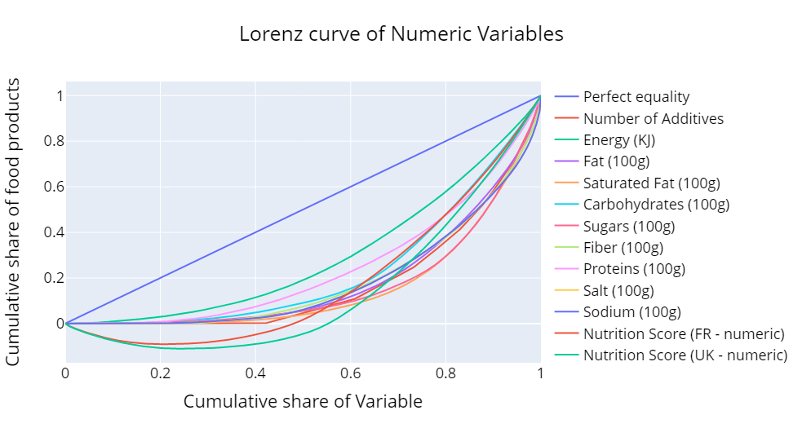
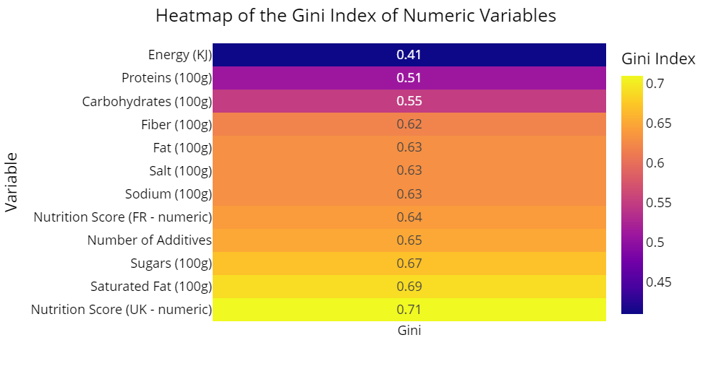
Concentration of nutrients
The concentration of all nutrients is highly unequal (Gini index > 0.5)
The concentration of energy is moderately unequal (Gini index = 0.41)
UK Nutrition Score and Saturated Fat are the most unequally distributed variables with Gini indexes ~= 0.7

Slide 12
Correlation Analysis

Slide 13
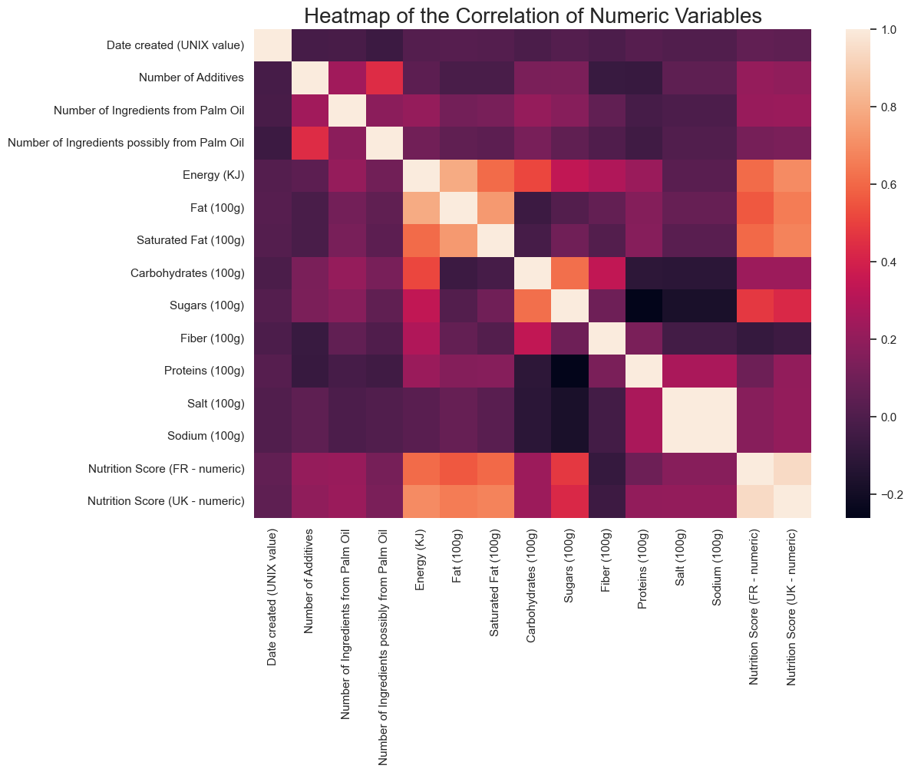
Correlation of numeric variables
Very strong correlation between UK-FR Nutri Scores and Salt and Sodium (R > 0.94)
Strong correlation between Fat and Saturated Fat (R = 0.72)
Moderate correlation between Sugars and Carbohydrates (R = 0.62)

Slide 14
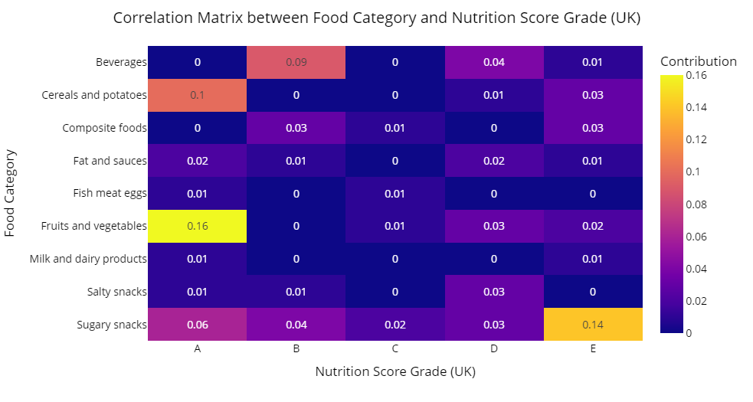
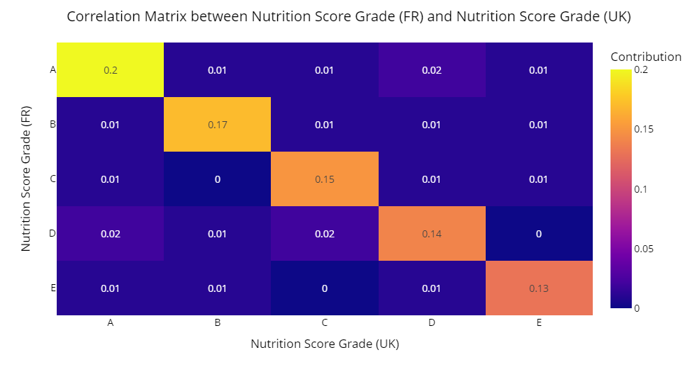
Association of categorical variables
Strong association between Nutrition Score UK and Nutrition Score FR (Cramer’s V = 0.75)
Moderate association between Food Category and Nutrition Score UK / FR (Cramer’s V = 0.37)

Slide 15
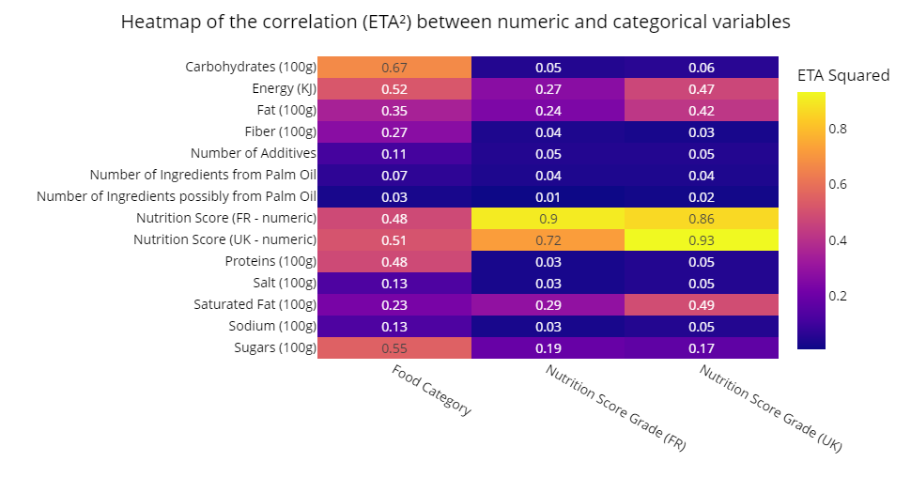
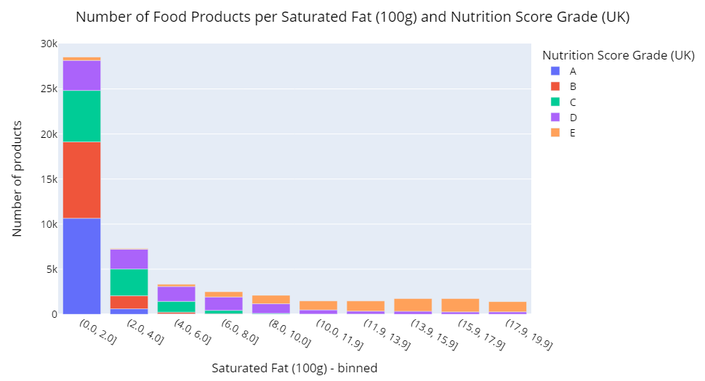
Correlation of numeric and categorical variables
Hypothesis : Correlation between Nutri-Score and Fat
Food category strongly correlated with several nutrients (Carbohydrates the most)
Strong correlation between Nutrition Score Grades (UK) and Saturated Fat
Moderate correlation between Nutrition Score and Fat / Energy

Slide 16
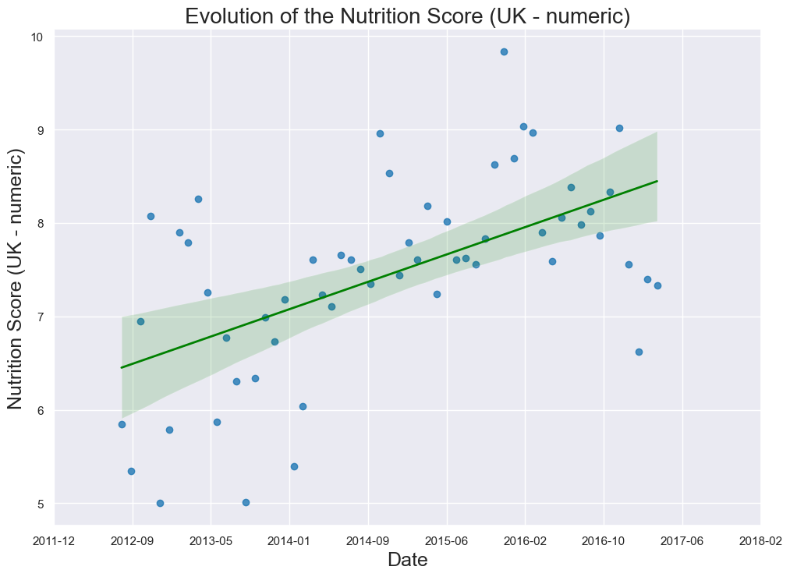
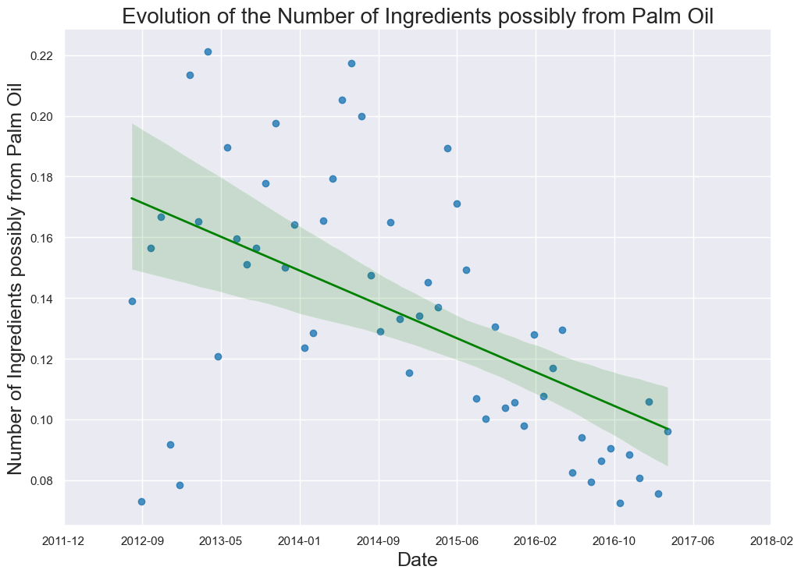
Time series Analysis
Hypothesis : Nutrition Score decreasing over time with healthy food trend
Hypothesis disproved by data, Nutrition Score is increasing over time (R = 0.57)
Number of Ingredients possibly from Palm Oil strongly decreasing (R = 0.55)

Slide 17
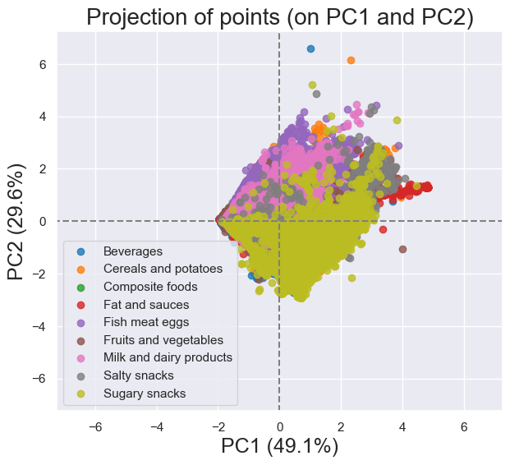
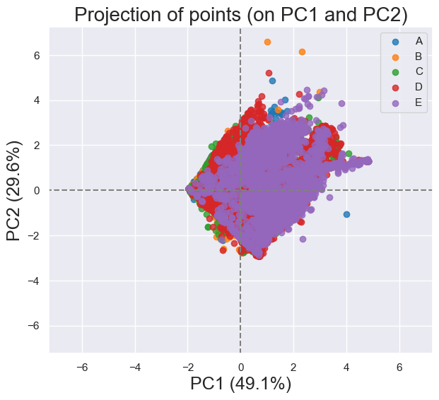
Applying Principal Component Analysis (PCA) to categories
Hypothesis : When keeping only nutrients, PCA would allow for a clean separation between foods with different nutrition scores
PCA is not able to differentiate between these products, even when keeping only nutrients as variables.

Slide 18
Conclusion

Slide 19
Conclusion
In this dataset, Sugary Snacks is the most represented category at ~20%
The distribution of Carbohydrates is widely spread with a high IQR.
None of the food products variables are normally distributed, and they all have an unequal concentration
There is a strong correlation between Saturated Fat and Nutrition Score
The average nutrition score of new entries is increasing over time ➔ New products are less healthy
The number of additives with palm oil is decreasing over time ➔ The campaign against the use of palm oil is working

Slide 20
Questions?

